Slide 1
IMPROVING CLASSIFICATION ACCURACY USING ENHANCED SALP SWARM ALGORITHM
Project made by-
Chakshu Mahajan(9916103073)
Divay Dua(9916103157)
Ayushmaan Pandey(9916103235)

Slide 2
PROBLEM STATEMENT
In our previous work, we had studied about Salp Swarm Algorithm and how this algorithm is better than other algorithms. We studied all the limitations of SSA and how it can be improved. We had also compared the results SSA with other Swarm intelligence algorithms (PSO, ABC, GSA, BA). But, SSA has certain limitations that can be optimized. We analysed and choose SSA for classification as it was better than others.
In this work, we propose to enhance the Salp Swarm Algorithm for improving machine learning classifiers, as it suffered from stagnation in local optima in some cases and low convergence rate.

Slide 3
STATE OF ART
Salp Swarm Algorithm: A bio-inspired optimizer for engineering design problems-This work proposes two novel optimization algorithms called Salp Swarm Algorithm (SSA) and Multi Objective Salp Swarm Algorithm (MSSA) for solving optimization problems with single and multiple objectives.
Training Neural Networks using Salp Swarm Algorithm for Pattern Classification-Pattern classification is one of the most popular applications of NN. This paper proposes the use of SSA to optimize the weights coefficients for the neural networks in order to perform pattern classification.
Fish Image Segmentation Using Salp Swarm Algorithm-In this research, a segmentation model is proposed for ﬁsh images using Salp Swarm Algorithm (SSA). The segmentation is formulated using Simple Linear Iterative Clustering (SLIC) method with initial parameters optimized by the SSA.

Slide 4
OBJECTIVE
In this work, we propose to enhance Salp Swarm Algorithm for improving classification accuracy, as it suffered from stagnation in local optima and low convergence rate. We had also compared the results SSA with other Swarm intelligence algorithms (PSO, ABC, GSA, BA). But, SSA has certain limitations which can be optimized.

Slide 5
LIMITATIONS
As we know most of the Swarm intelligence algorithms suffer from stagnation in local optima for some cases and slow convergence rate and SSA faces challenges while dealing with higher dimension multimodal problems. But our approach can prove that the enhanced SSA can deal with these demerits of Swarm intelligence only by making small changes in the parameters and show high convergence rate and better classification accuracy.

Slide 6
PROPOSED DESIGN OF SSA
SSA mimics the swarming and navigation behavior of salps in oceans for food. Salps belong to the Salpidae family having a transparent bottle shaped body. Salps form chains like flock or swarms in the deep ocean for navigation and foraging process.
Salp chain has two levels of hierarchy: leader and followers. The leader is at the front and guides the swarm (followers) during navigation in multidimensional search space finding the best solution (food sources) to an optimization problem.
SSA starts with random solutions and then iterates to find best fitness of each salp by exploring and exploiting the search space. The salps move in N-dimensional search space, and the leader’s salp position is updated based on the distance between the salp and food source using the following equation:

Slide 7
SSA algorithm saves the best solution obtained so far and assigns it to the food source variable, so it never get lost even if the whole population deteriorates
SSA algorithm updates the position of the leading salp with respect to the food source only, which is the best solution obtained so far, so the leader always explores and exploits the space around it.
SSA algorithm updates the position of follower salps with respect to each other, so they move gradually towards the leading salp.
Gradual movements of follower slaps prevent the SSA algorithm from easily stagnating in local optima.
Parameter c1 is decreased adaptively over the course of iterations, so the SSA algorithm ﬁrst explores the search space and then exploits it.

Slide 8
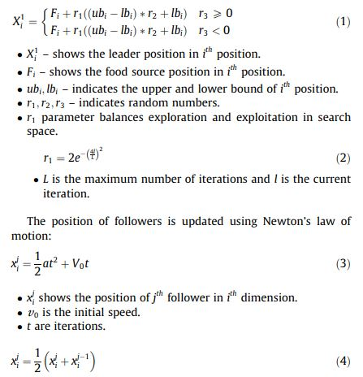

Slide 9
SOLUTION APPROACH
We propose the approach of moulding the parameters of relatively simple Salp Swarm algorithm which we studied in our previous project and improving its accuracy such that these results are better for this problem statement. We can achieve this by bringing balance in exploration and exploitation. We can achieve this balance by moulding parameters of Salp Swarm Algorithm like introducing weighted parameters, changing mutation function.
We have combined SSA with K-nearest neighbour(KNN) classifier and assessed our setup on several datasets.

Slide 10
IMPLEMENTATION
We observed that the main parameter in SSA is the first one i.e. c1 as it is used to converge the leader salp with the Food Particle (Solution).
C1 is an exponential parameter (2*Exp (-4l/L) ^2) which can be changed to enhance the SSA Algorithm.
We observed that values in the range of 1 to 2 when multiplied in exponent’s power numerator it gives results that are consistent and better than original SSA.
We multiplied 1.5 in numerator and got very good results that is we need to exchange 4 with 6 in the numerator. We applied several unimodal and multimodal benchmark functions to evaluate our changes.

Slide 11
For the classification purpose we used KNN classifiers and for the task of feature selection we used ESSA.
We used attributes such as correct rate and error rate of classperf to calculate the classification accuracy and fitness value.
We compared our setup with several other bio-inspired optimization algorithms.

Slide 12
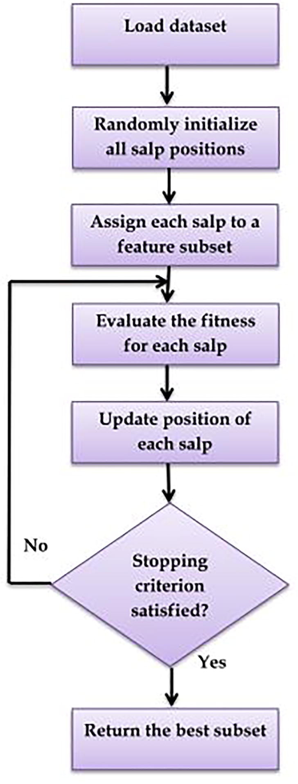
ESSA feature selection flowchart

Slide 13
DATASET DESCRIPTION
To verify the effectiveness of the proposed ESSA method, 23 benchmark datasets were applied which were taken from UCI repository. The education set is applied to build optimum function set and check set is applied to estimate type accuracy to assess the reliability and effectiveness of the method.

Slide 14
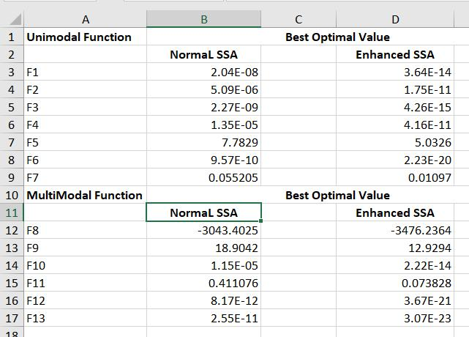
FINDINGS AND RESULTS
Comparison SSA vs Enhanced SSA

Slide 15
We observed that the performance of the proposed ESSA algorithm is greater than standard SSA and other nature inspired algorithms. In majority of datasets, enhanced SSA out performed other optimizers.
The ESSA gets the best values in majority of datasets, despite SSA and ALO get the best results than ESSA for five datasets.

Slide 16
DS | ESSA | SSA | GA | PSO | ALO | GWO | FULL
Wine | 0.9780 | 0.9550 | 0.9570 | 0.9230 | 0.9420 | 0.9120 | 0.9310
Hepatitis | 0.9123 | 0.8939 | 0.8750 | 0.8605 | 0.8825 | 0.8479 | 0.8462
Vehicle | 0.7398 | 0.7352 | 0.7163 | 0.6695 | 0.6814 | 0.6172 | 0.6489
Zoo | 0.9700 | 0.7980 | 0.8540 | 0.8240 | 0.8050 | 0.8750 | 0.8314
Heart | 0.8130 | 0.8130 | 0.8240 | 0.8220 | 0.8020 | 0.8070 | 0.8105
Breastcancer | 0.9712 | 0.9550 | 0.9550 | 0.9510 | 0.9500 | 0.9530 | 0.9530
Ionosphere | 0.9760 | 0.8360 | 0.8240 | 0.8480 | 0.8430 | 0.8190 | 0.8168
Lung cancer | 0.5978 | 0.6023 | 0.4820 | 0.5627 | 0.5056 | 0.5014 | 0.4156
Dermatlogy | 0.9732 | 0.9623 | 0.9645 | 0.9071 | 0.9322 | 0.9488 | 0.8158
Sonar | 0.7340 | 0.7370 | 0.7170 | 0.7230 | 0.7140 | 0.7140 | 0.7019
BreastEW | 0.9610 | 0.9420 | 0.9350 | 0.9490 | 0.9420 | 0.9490 | 0.9311
SoybeanSmall | 0.9708 | 0.9736 | 0.9438 | 0.8648 | 0.9098 | 0.9205 | 0.875
Movementlibras | 0.6938 | 0.6899 | 0.6902 | 0.6466 | 0.6597 | 0.6866 | 0.6436
Parkinsons | 0.9702 | 0.8429 | 0.8492 | 0.8653 | 0.8367 | 0.8367 | 0.8087
Spambase | 0.8814 | 0.8735 | 0.8229 | 0.8735 | 0.8804 | 0.8839 | 0.7807
Waveform | 0.7660 | 0.7690 | 0.7620 | 0.7620 | 0.7690 | 0.7650 | 0.7569
Arrhythmia | 0.6600 | 0.6378 | 0.5802 | 0.5707 | 0.5462 | 0.5641 | 0.5629
Multiple Features | 0.9611 | 0.9468 | 0.9286 | 0.9359 | 0.9255 | 0.9106 | 0.9265
Semeion | 0.9899 | 0.9595 | 0.9578 | 0.9314 | 0.9807 | 0.9732 | 0.9537
Clean | 0.8098 | 0.8098 | 0.7648 | 0.7784 | 0.8098 | 0.7953 | 0.7601
CNAE | 0.8912 | 0.8514 | 0.8246 | 0.8147 | 0.7962 | 0.8407 | 0.8083
DNA | 0.8611 | 0.8429 | 0.7954 | 0.7979 | 0.7666 | 0.8425 | 0.7856
Hillvalley | 0.6319 | 0.6319 | 0.5627 | 0.5507 | 0.5709 | 0.5544 | 0.5411
DS | ESSA | SSA | PSO | GA | ALO | GWO
Wine | 0.0000 | 0.0039 | 0.0159 | 0.0000 | 0.0642 | 0.0410
Hepatitis | 0.0682 | 0.0669 | 0.0854 | 0.0647 | 0.1883 | 0.1954
Vehicle | 0.2310 | 0.1899 | 0.1986 | 0.1723 | 0.2377 | 0.2535
Zoo | 0.0000 | 0.0299 | 0.0609 | 0.1727 | 0.1782 | 0.1006
Heart | 0.1200 | 0.0889 | 0.0779 | 0.1452 | 0.1567 | 0.1293
Breastcancer | 0.0092 | 0.0339 | 0.0339 | 0.0272 | 0.0312 | 0.0395
Ionosphere | 0.0770 | 0.0939 | 0.0879 | 0.1289 | 0.1112 | 0.1412
Lung cancer | 0.0245 | 0.0289 | 0.0001 | 0.0312 | 0.1898 | 0.253
Dermatlogy | 0.0000 | 0.0159 | 0.0000 | 0.0168 | 0.0338 | 0.0221
Sonar | 0.1720 | 0.0709 | 0.0479 | 0.2900 | 0.1673 | 0.2132
BreastEW | 0.0152 | 0.0209 | 0.0258 | 0.0457 | 0.0626 | 0.0652
SoybeanSmall | 0.0270 | 0.0338 | 0.0237 | 0.0354 | 0.0017 | 0.1943
Movementlibras | 0.0839 | 0.2699 | 0.2767 | 0.3367 | 0.3728 | 0.2700
Parkinsons | 0.0279 | 0.0428 | 0.0546 | 0.0646 | 0.0963 | 0.1033
Spambase | 0.2015 | 0.1919 | 0.1919 | 0.2647 | 0.2737 | 0.2794
Waveform | 0.2350 | 0.1869 | 0.2546 | 0.2643 | 0.2736 | 0.2596
Arrhythmia | 0.0301 | 0.0289 | 0.0364 | 0.0810 | 0.0368 | 0.0353
Multiple Features | 0.0801 | 0.1599 | 0.1673 | 0.1382 | 0.0431 | 0.0437
Semeion | 0.0089 | 0.0359 | 0.0779 | 0.1409 | 0.0945 | 0.0823
Clean | 0.0099 | 0.0399 | 0.0399 | 0.0400 | 0.0144 | 0.0189
CNAE | 0.1249 | 0.1739 | 0.1739 | 0.2499 | 0.1118 | 0.1419
DNA | 0.0899 | 0.1239 | 0.1459 | 0.1349 | 0.1125 | 0.1420
Hillvalley | 0.1939 | 0.2099 | 0.2189 | 0.2210 | 0.3978 | 0.3890
Average | 0.0742 | 0.0935 | 0.0980 | 0.1291 | 0.1358 | 0.1482
Avg classification accuracy of 20 runs for all optimizers
Statistical Best fitness values of 20 runs for all optimizers

Slide 17
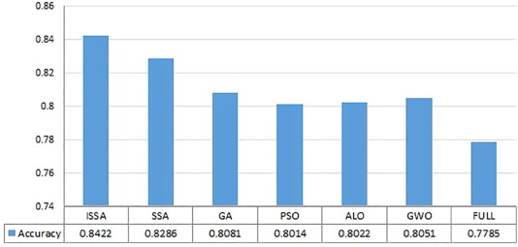
Avg. Classification accuracy of all Algorithms

Slide 18
CONCLUSION
This project delivered a novel nature-inspired algorithm for solving optimization problems. The swarming behaviour of salps (salp chain) was the main inspiration of this paper.
In this work, we have introduced an enhanced salp swarm algorithm for improving classification accuracy. The performance of the ESSA algorithm is evaluated on wonderful small, medium, and massive length datasets, and we compared it with the existing SSA and various nature inspired algorithms like PSO,GA,ALO etc.
The proposed enhanced version of SSA has outperformed the other optimization techniques in type accuracy.

Slide 19
FUTURE SCOPE
Enhanced Salp Swarm Algorithm can be used in enhancing the accuracy in Machine learning image classifiers and results already tells us that it stands out in terms of accuracy and performance.

Slide 20
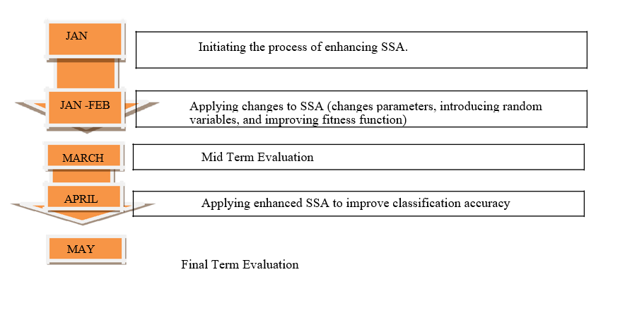
FLOW DIAGRAM

